Slide 1
Challenges in Internet of things (IoT)
Security challenges in IoT :
1.Lack of encryption – Although encryption is a great way to prevent hackers from accessing data, it is also one of the leading IoT security challenges. The result is an increase in attacks where hackers can easily manipulate the algorithms that were designed for protection.
2.Insufficient testing and updating – With the increase in the number of IoT(internet of things) devices, IoT manufacturers are more eager to produce and deliver their device as fast as they can without giving security too much of although. Most of these devices and IoT products do not get enough testing and updates and are prone to hackers and other security issues.
3.Brute forcing and the risk of default passwords – Weak credentials and login details leave nearly all IoT devices vulnerable to password hacking and brute force. Any company that uses factory default credentials on their devices is placing both their business and its assets and the customer and their valuable information at risk of being susceptible to a brute force attack.

Slide 2
Design challenge in IoT :
1.Increased cost and time to market – Embedded systems are lightly constrained by cost. The need originates to drive better approaches when designing the IoT devices in order to handle the cost modelling or cost optimally with digital electronic components.
2.Security of the system – Systems have to be designed and implemented to be robust and reliable and have to be secure with cryptographic algorithms and security procedures. It involves different approaches to secure all the components of embedded systems from prototype to deployment.

Slide 3
Deployment challenges in IoT :
1.Connectivity – It is the foremost concern while connecting devices, applications and cloud platforms. Connected devices that provide useful front end information are extremely valuable. But poor connectivity becomes a challenge where IoT sensors are required to monitor process data and supply information.
2.Cross platform capability – IoT applications must be developed, keeping in mind the technological changes of the future. Its development requires a balance of hardware and software functions. It is a challenge for IoT application developers to ensure that the device and IoT platform drivers the best performance despite heavy device rates and fixings.
3.Data collection and processing – In IoT development, data plays an important role. What is more critical here is the processing or usefulness of stored data. Along with security and privacy, development teams need to ensure that they plan well for the way data is collected, stored or processed within an environment.

Slide 4
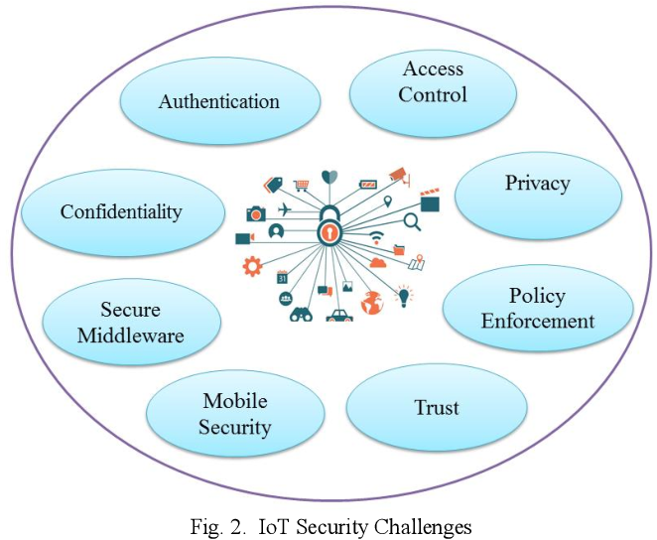

Slide 5
What Is an IoT Network?
An IoT network refers to a collection of devices such as sensors, gadgets, appliances, and software that communicate with each other and exchange information and data without the need for human intervention.
If you’ve ever turned your lights on from your phone or told Alexa to play your favorite song, you’ve experienced the power of an IoT network.

Slide 6
The three layers of IoT architecture
Even though there's no single IoT architecture that's universally agreed upon, the most basic and widely accepted format is a three-layer architecture.
It proposes three layers: Perception, Network, and Application.
1.Perception layer: This is the physical layer of the architecture. This is where the sensors and connected devices come into play as they gather various amounts of data as per the need of the project. These can be the edge devices, sensors, and actuators that interact with their environment.
2.Network layer: The data that's collected by all of these devices needs to be transmitted and processed. That's the network layer's job. It connects these devices to other smart objects, servers, and network devices. It also handles the transmission of all of the data.
3.Application layer: The application layer is what the user interacts with. It's what is responsible for delivering application specific services to the user. This can be a smart home implementation, for example, where users tap a button in the app to turn on a coffee maker.

Slide 7
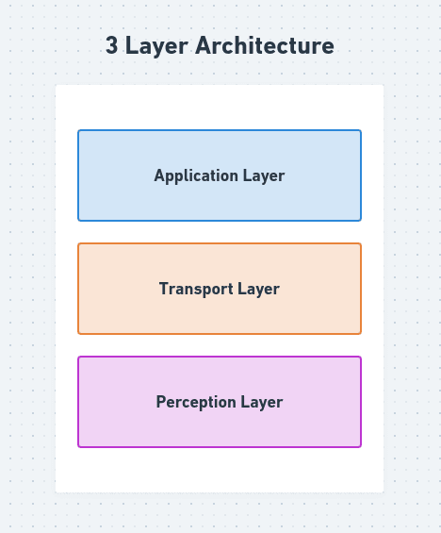

Slide 8
Types of IoT Networks
There are a few different ways administrators can design their IoT networks. One of the biggest differences is what protocol sensors use to share information. Keep in mind a single IoT network can use a combination of these options for different applications.
Enterprise Wi-Fi
Wi-Fi is a popular choice for IoT networks since many businesses already have Wi-Fi coverage across their organization. Wi-Fi is a solid option for stationary IoT sensors that need to share data across a medium range.
However, Wi-Fi IoT networks aren’t without their drawbacks.
Due to their power limitations, Wi-Fi networks don’t offer as much coverage as cellular networks. Wi-Fi networks also don’t process device handover as smoothly as cellular networks, meaning mobile IoT sensors might experience connectivity issues on Wi-Fi networks. Wi-Fi IoT networks are best for the following uses:
Small- to medium-sized networks
Indoor areas with few obstructions

Slide 9
2.Private Cellular
Cellular networks offer long-range reliable connectivity for both stationary and mobile IoT sensors. Autonomous vehicles can rely on public cellular networks for latency connectivity and very large area coverage across cities.
Since private cellular networks operate on a different frequency than Wi-Fi, both networks can coexist in the same space without interference. This allows enterprises to segment their traffic and reserve their private 5G implementations for critical IoT infrastructure. The improved reliability, coverage, and capacity private cellular networks provide make this design a popular choice among large enterprises and businesses that must meet strict service-level objectives for IoT connectivity and performance.

Slide 10
3.Bluetooth
Bluetooth has been around since 1994, but that doesn’t make it any less viable for IoT networks. Bluetooth offers an affordable way to connect stationary IoT sensors to edge devices over short distances.
In most use cases, IoT networks using Bluetooth can send signals up to 25 feet away using very little power and bandwidth. While Bluetooth isn’t the most popular choice, it does have its place in IoT networks.
Bluetooth IoT networks are best for the following uses:
Short distances
Low-power consumption requirements
4.Low-Power Wide Area Networks
An LPWAN uses specialized cellular connections that provide ample coverage while serving low-power devices. These networks offer coverage similar to that of cellular networks but are limited in terms of bandwidth and data rate. Oil fields, agricultural operations, and rural job sites can leverage LPWAN for their low-power IoT sensors. While these networks tend to be less expensive, businesses that want to expand their IoT network to include high bandwidth sensors often switch from LPWAN to a full cellular solution.

Slide 11
LPWAN IoT networks are best for the following uses:
Low-power sensors
Low data rates and bandwidth
Rural areas with limited infrastructure
‍

Slide 12
What Are Some Benefits of the Internet of Things?
Automation and Control
Perhaps one of the simplest examples of automation and control via an IoT smart device is the humble light bulb. So-called smart bulbs that can connect to the home network have really exploded in popularity. They provide people with the ability to control when lights are turned on and off, as well as other functions.
Remote Health Monitoring
In a world where communication is key, and where early detection is important, IoT devices can be incredibly useful. Imagine a health bracelet with an embedded monitoring system that can keep an eye on blood sugar levels, for example. This internet-connected diabetic bracelet can log blood sugar levels and send notifications directly to other family members and even medical personnel.
Cost Reduction
Cost reductions are widespread when devices are connected and networked. This machine-to-machine mesh of data not only provides real-time data and opportunities for analysis, but also enables much greater improvements in efficiency across the board. For example:Sensors in lights turn on only at times when people are moving through areas, thus saving on utility costs.

Slide 13
Better Quality of Life:
There are many instances where the convergence of big data and IoT can create better outcomes for people. For example, The use of smart devices in cars and other vehicles can connect wirelessly to toll gates, traffic lights ahead, and road safety monitors to provide real-time feedback to drivers and authorities on traffic conditions and the risk of accidents.
Improved Efficiency
By its very definition, the Internet of Things operates without human intervention. It is a system relying solely on machine-to-machine communication, with data logged and collected in real-time, at any time of day or night. One of the most significant impacts of such a system is the increased efficiency of a wide range of services.
Higher Productivity
The Internet of Things can also improve efficiency and productivity at work and in the industrial sector, similar to how voice-activated Amazon and Google products increase efficiency at home.

Slide 14
Need of IoT in different areas:
Smart Agriculture.
Retail.
Industrial level.
Mobility.
Health.
Smart Water.
Waste Management.
Home.
Sports.
Smart Buildings.
Logistics.
Environment.

